Slide 1
MG School for Excellence
Affiliated to CISCE, New Delhi
NURSERY – CLASS 12
Bilekahalli, Bangalore - 560078
ANNUAL REPORT

Slide 2
MG School for Excellence
Affiliated to CISCE, New Delhi
NURSERY – CLASS 12
Bilekahalli, Bangalore - 560078
Silver Jubilee Celebration

Slide 3
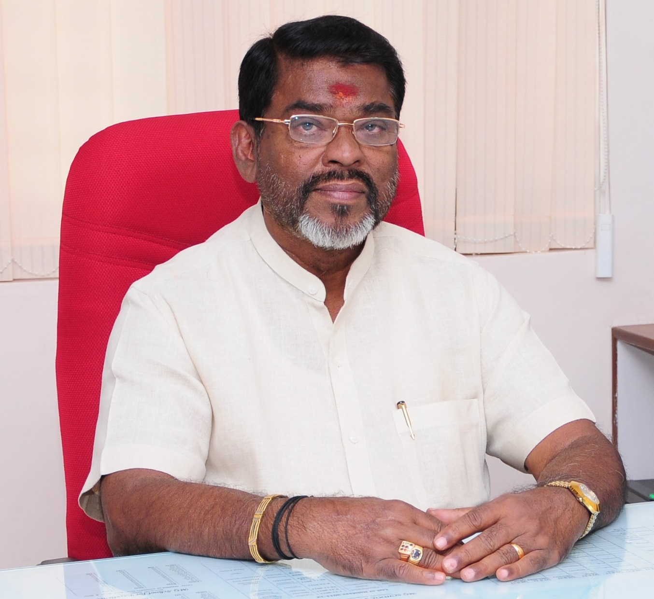
Founder
Sri. M.Gopalakrishnan

Slide 4
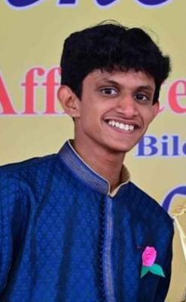
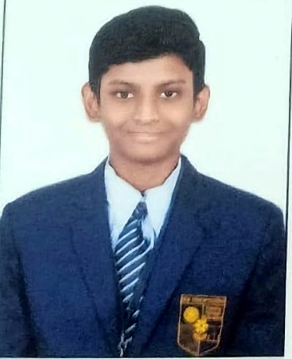
School Toppers
ICSE - Class 10
ISC - Class 12
Tata Pranay Nandan
98%
Alvin Lil Shaji
Commerce Topper
96%
Rithvik Gurukishan
Science Topper
92%

Slide 5
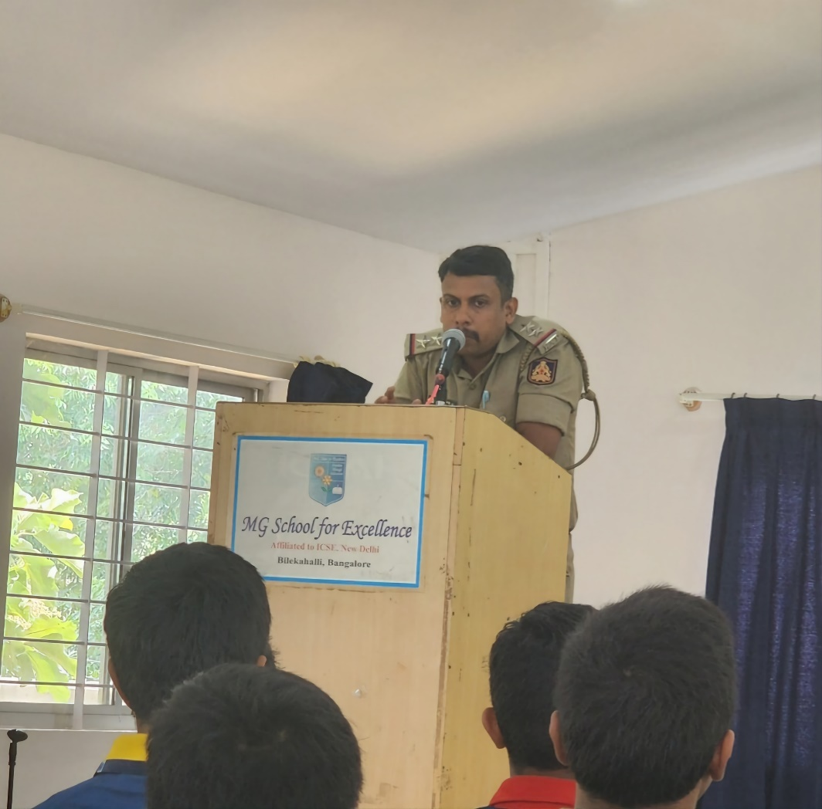
World No Tobacco Day

Slide 6
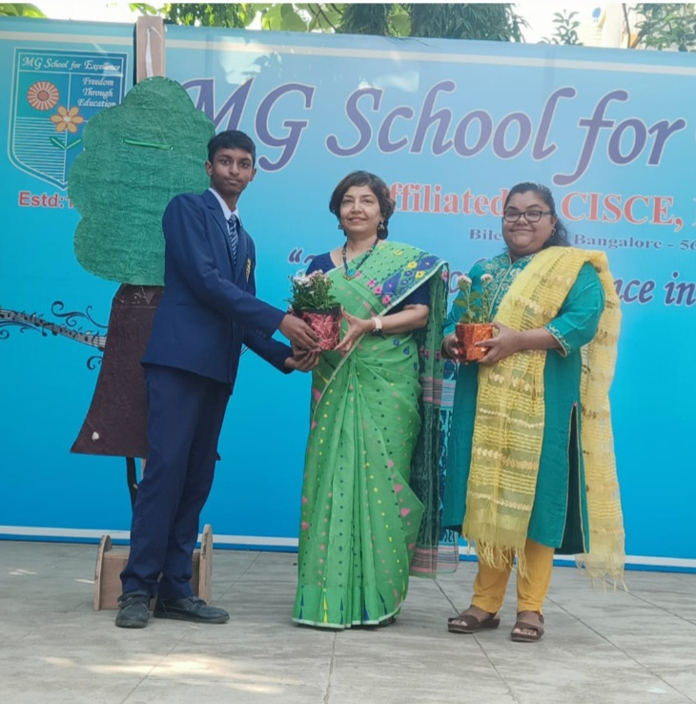
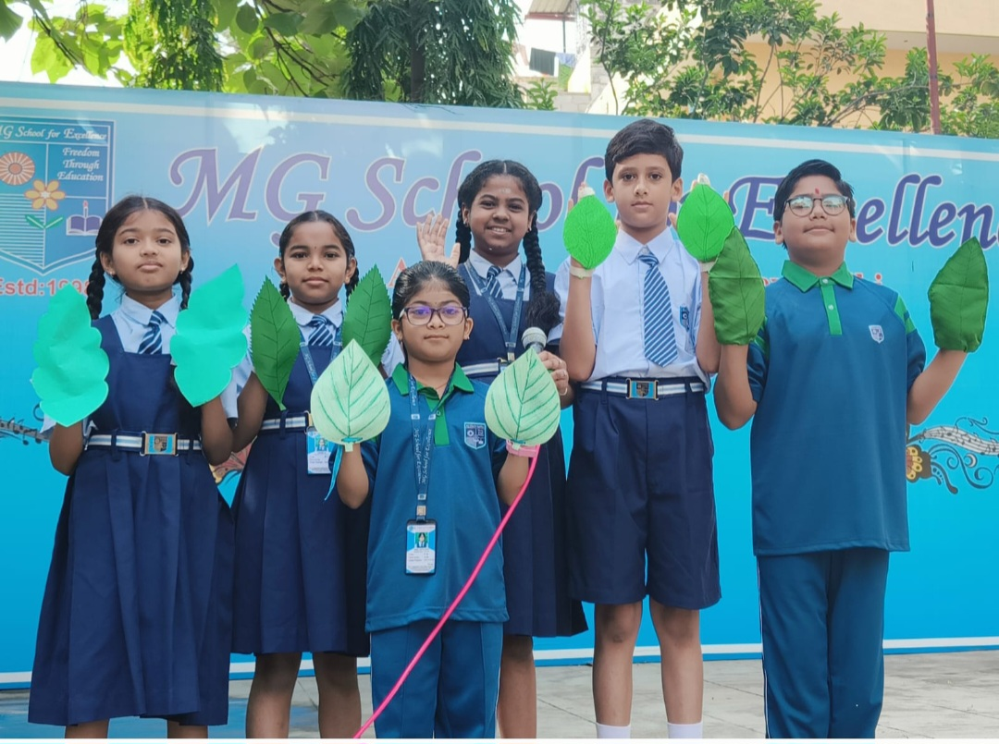
World Environment Day

Slide 7
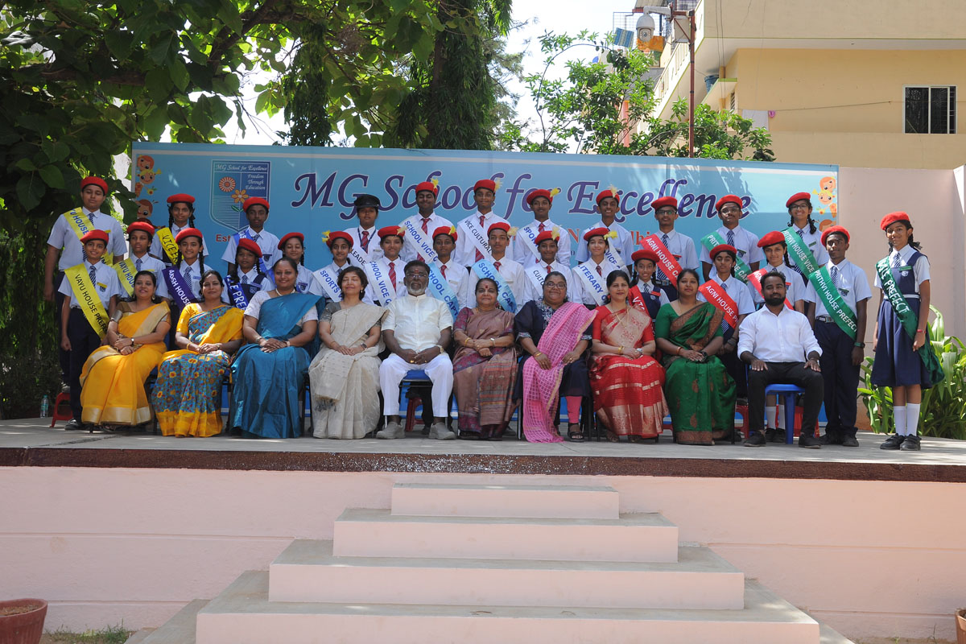
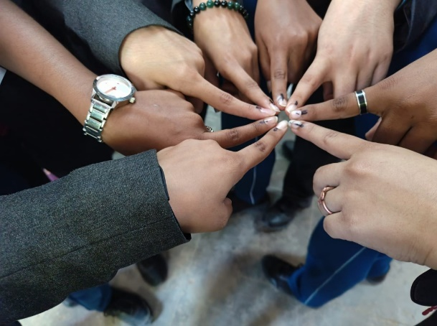
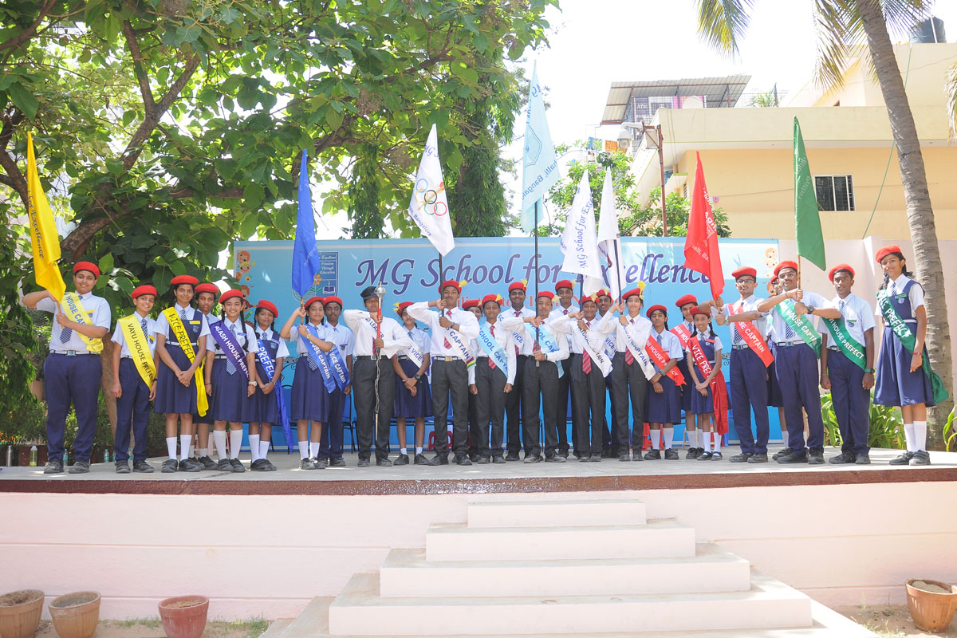
Investiture Ceremony

Slide 8
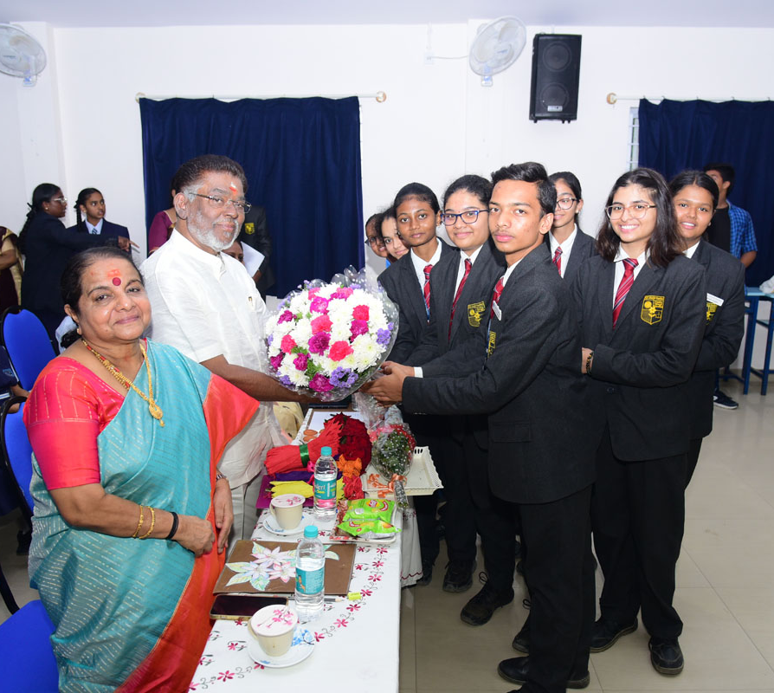
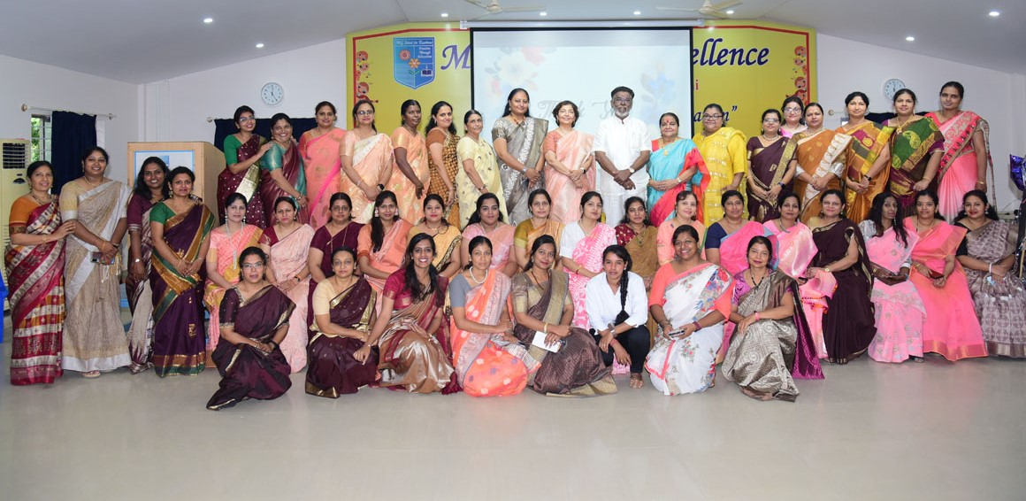
Founder’s Day

Slide 9
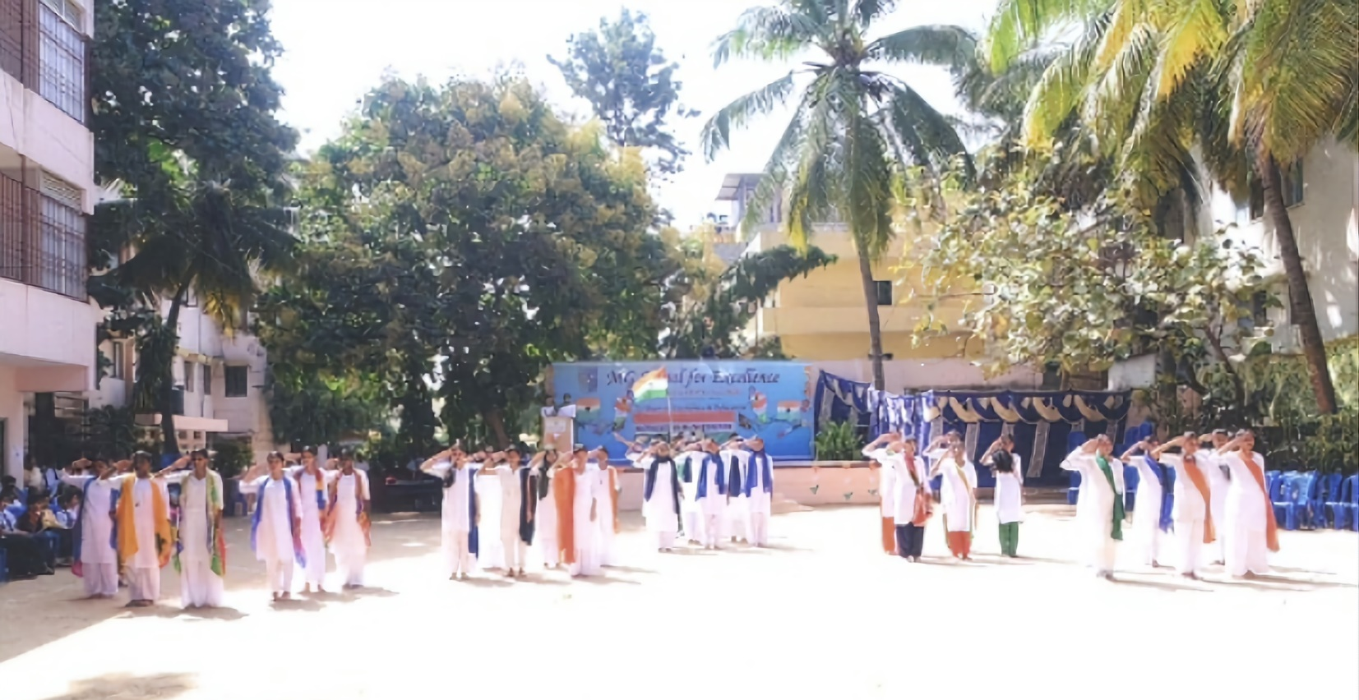
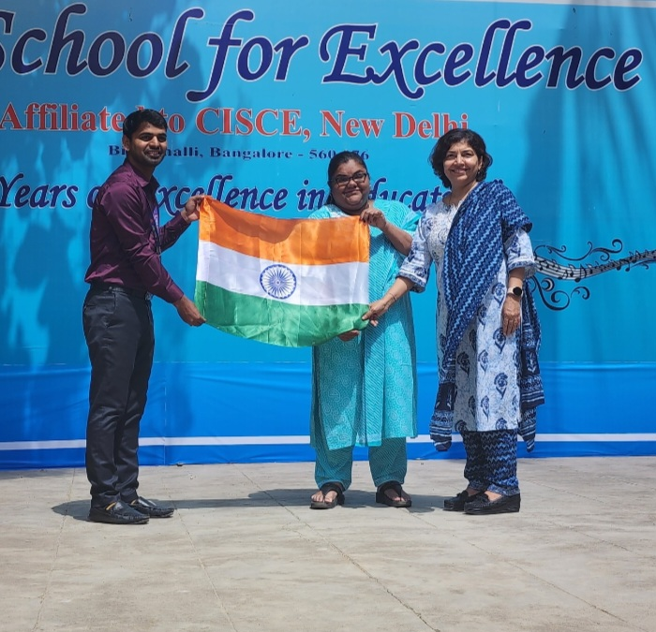
Independence Day

Slide 10
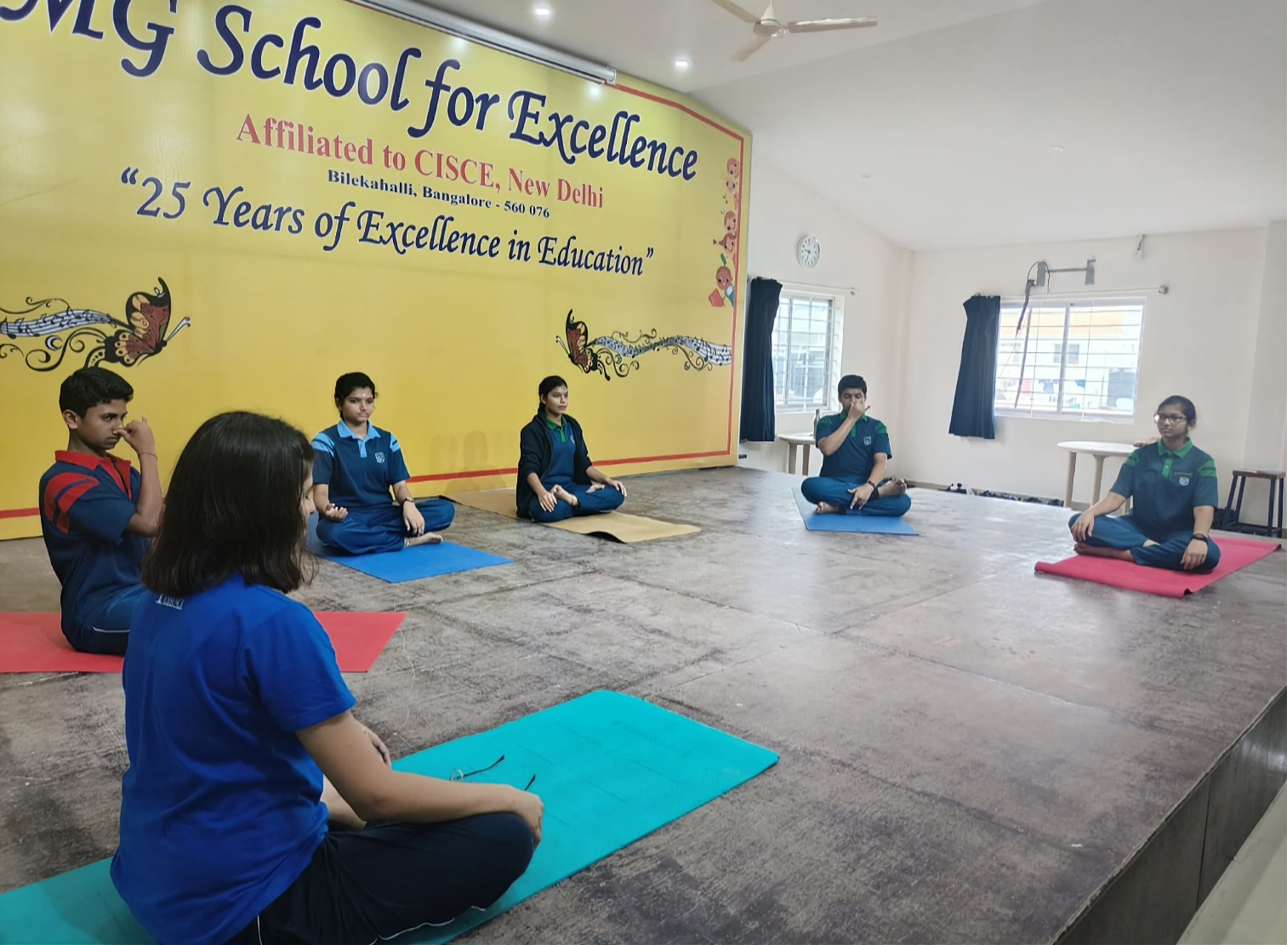
Yoga Day

Slide 11
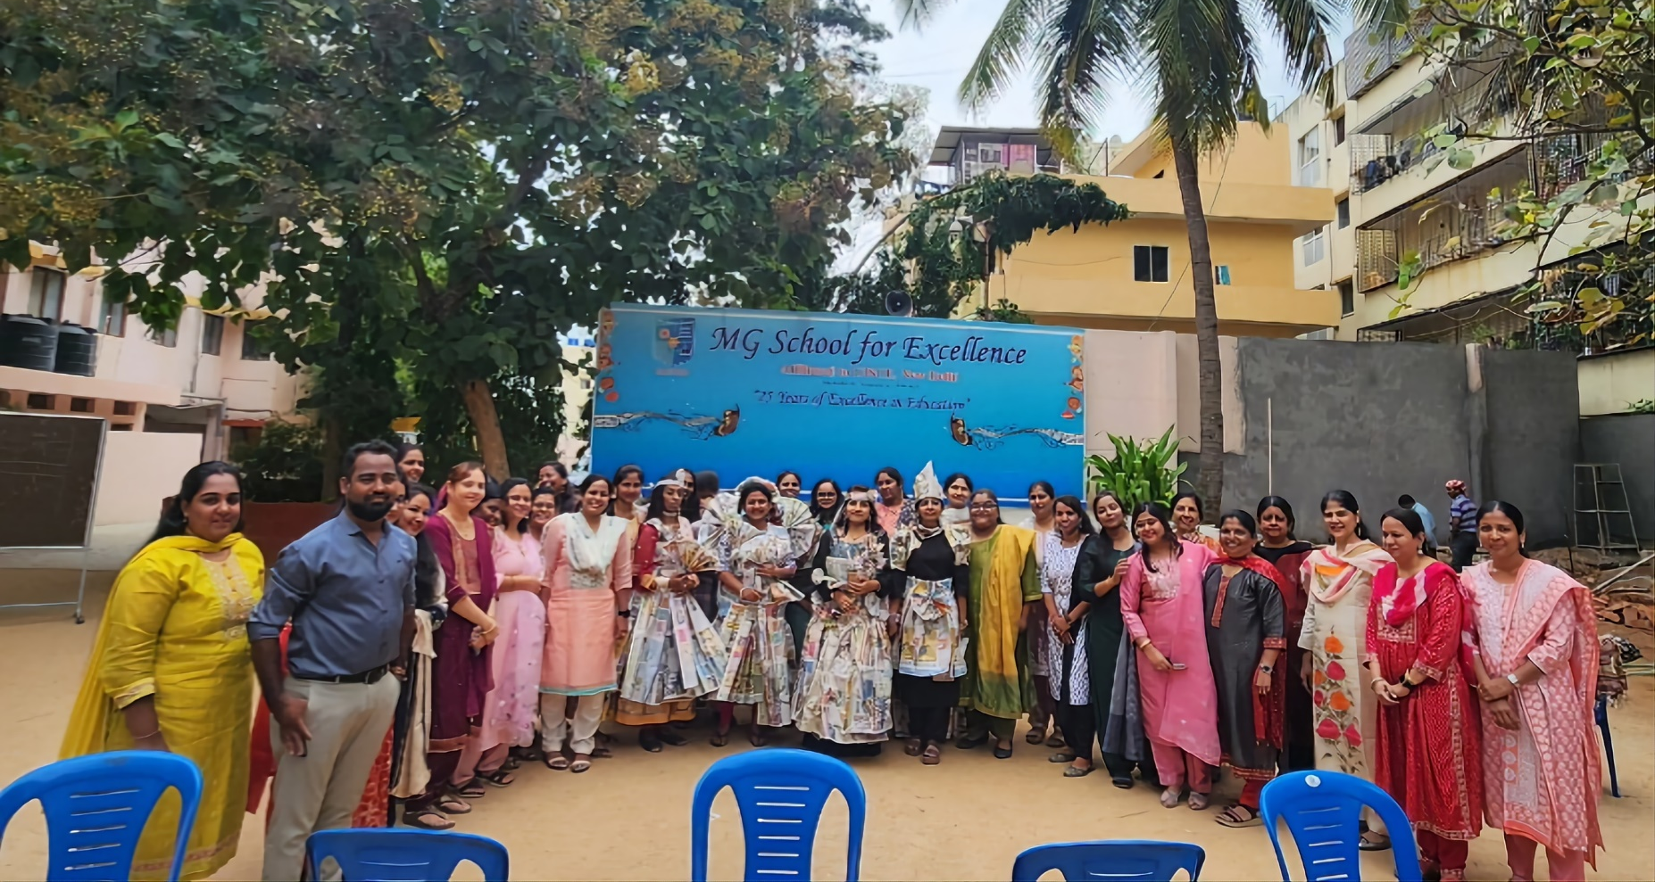
Teachers’ Day

Slide 12
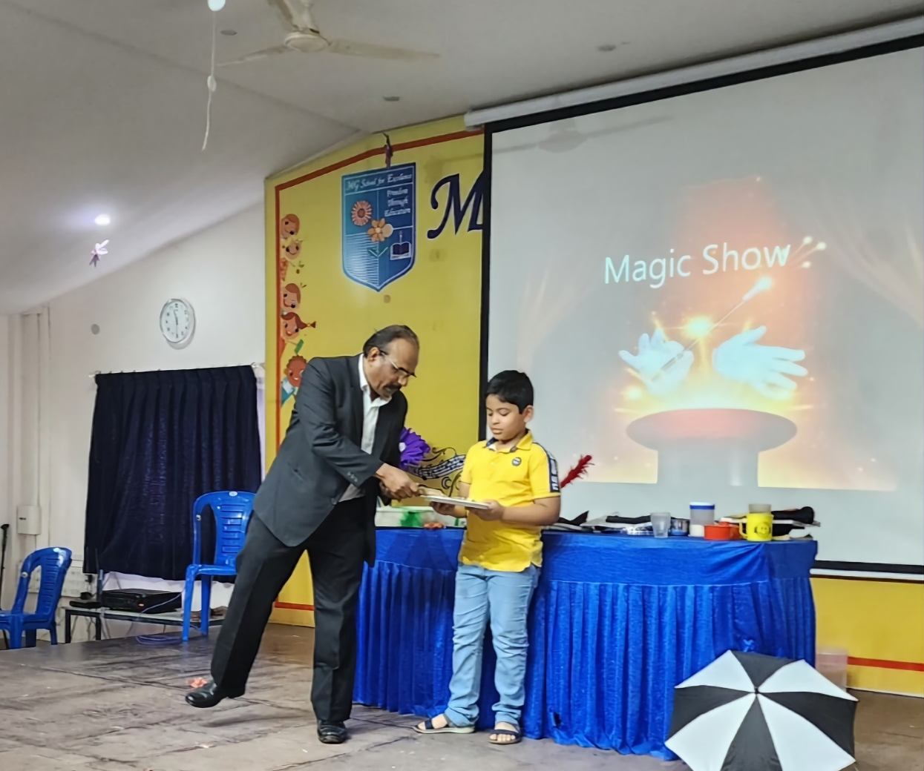
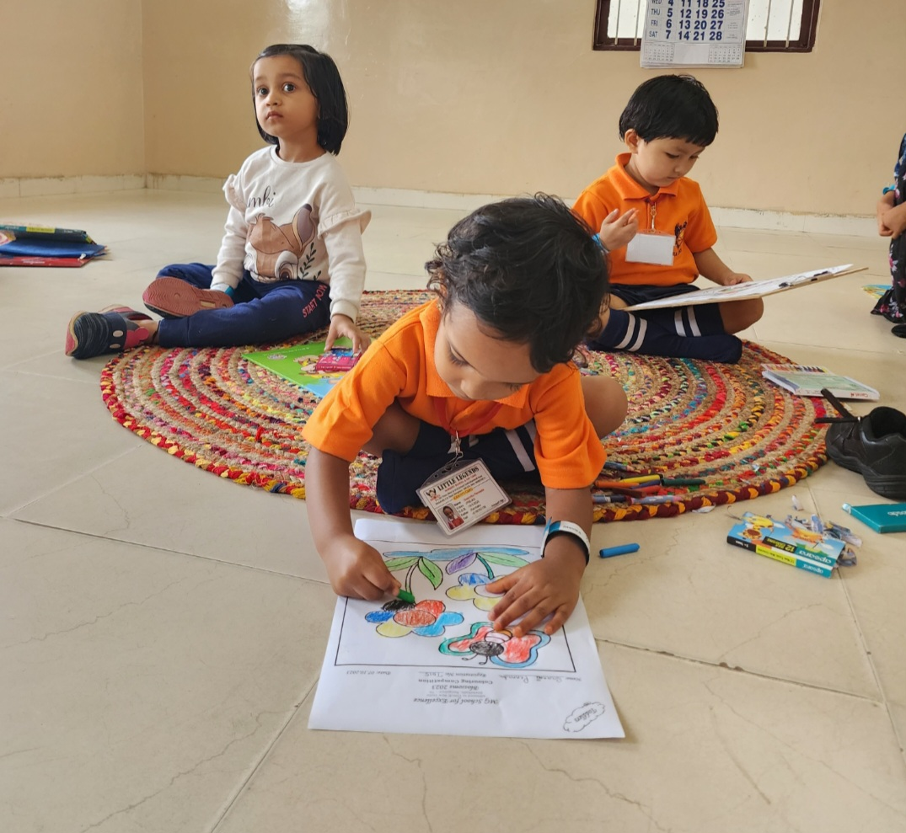
MG Blossom

Slide 13
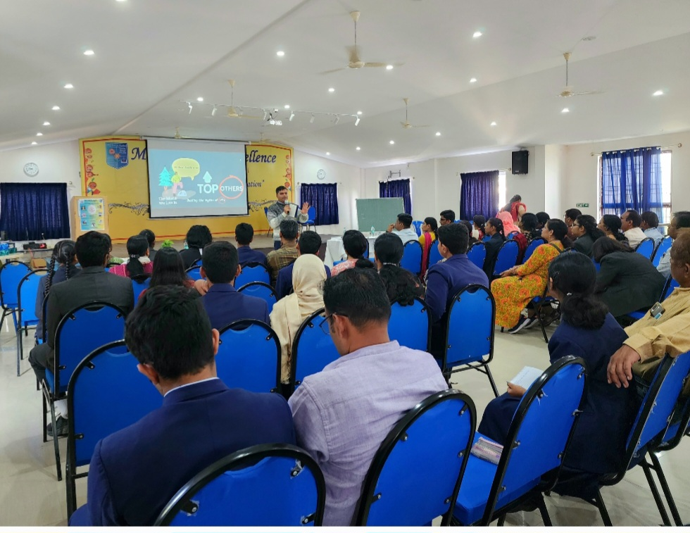
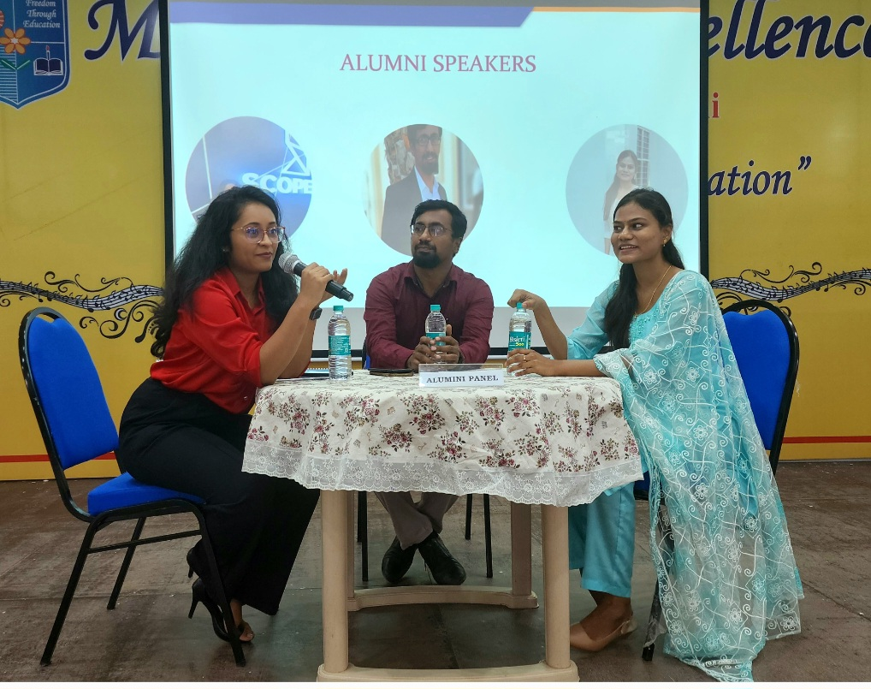
MG Career Spectrum

Slide 14
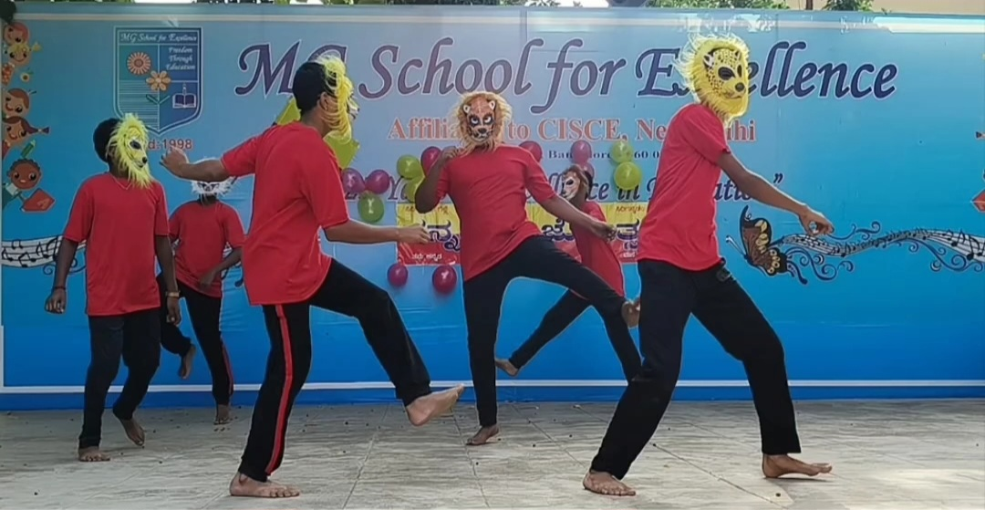
Kannada Rajyotsava

Slide 15
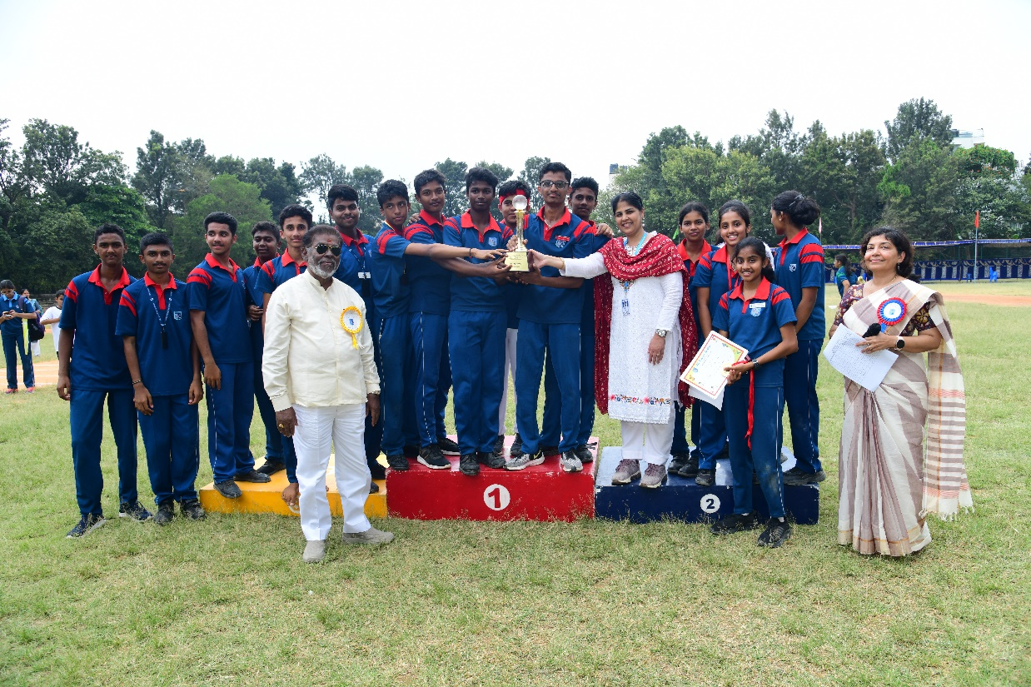
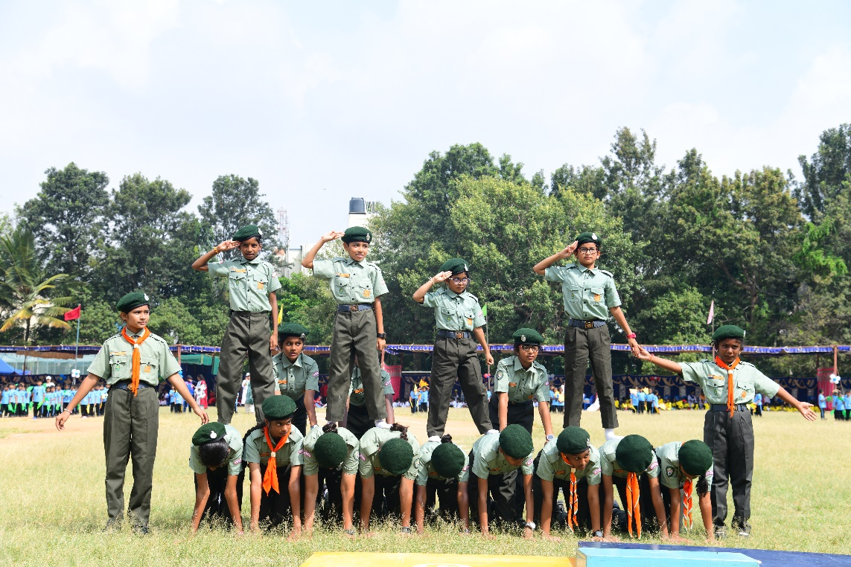
Sports Meet

Slide 16
MG Echoes

Slide 17
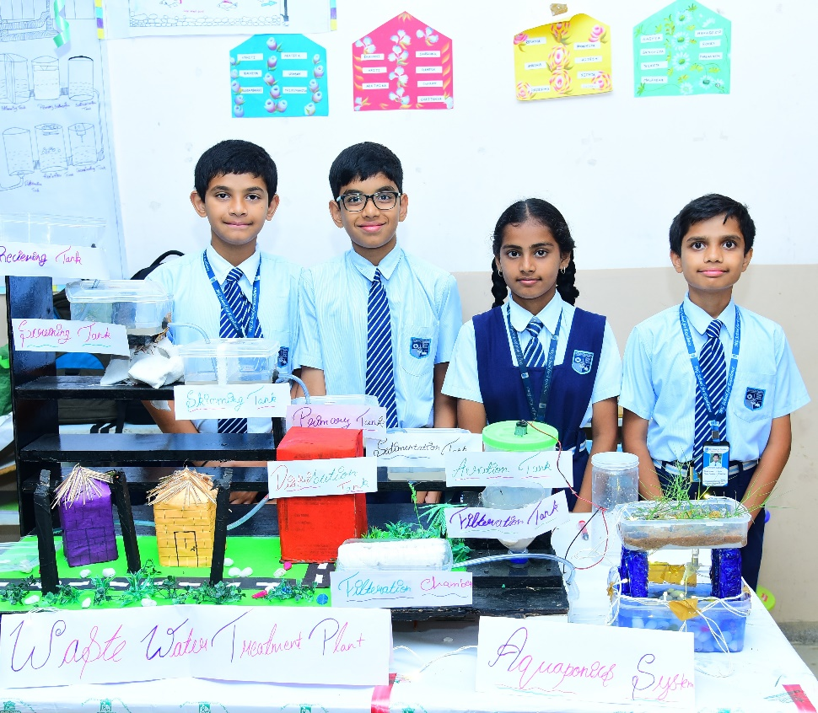
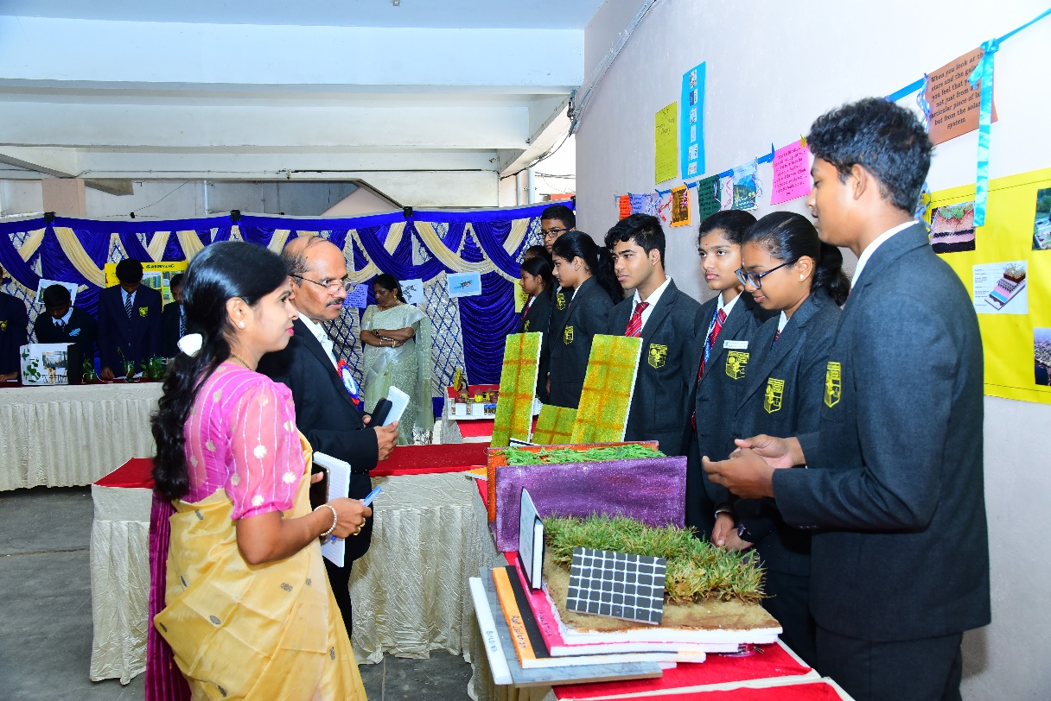
Nexus

Slide 18
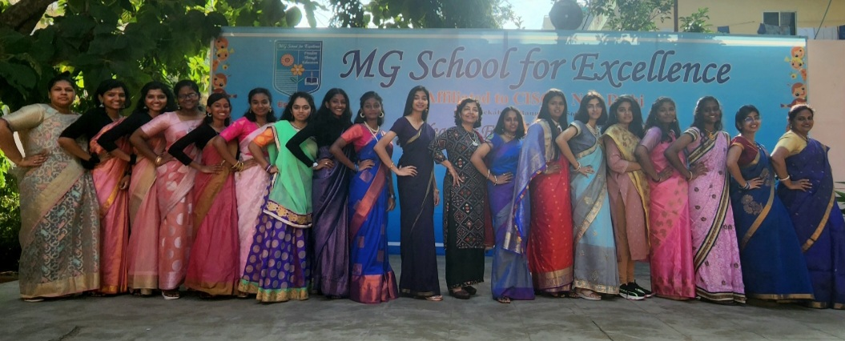
Ethnic Day

Slide 19
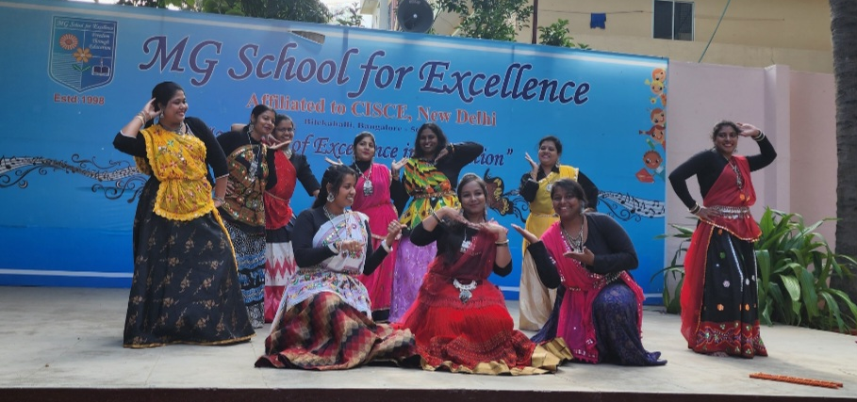
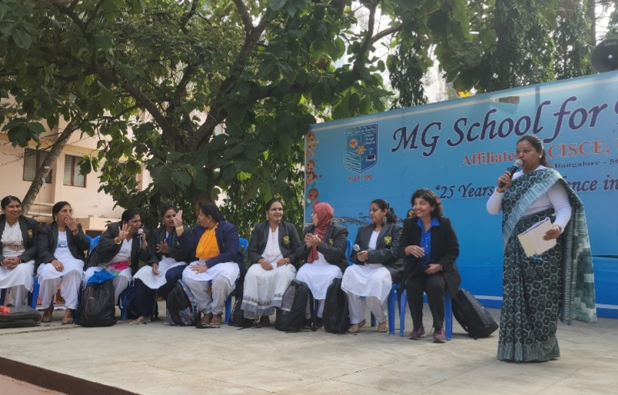
Children’s Day

Slide 20
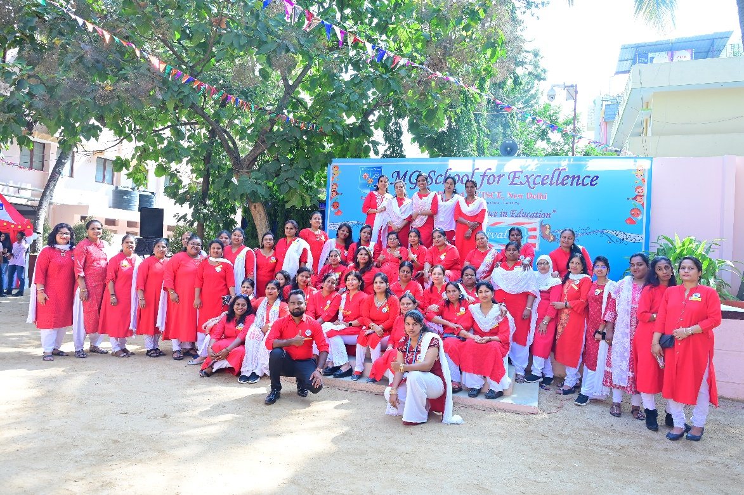
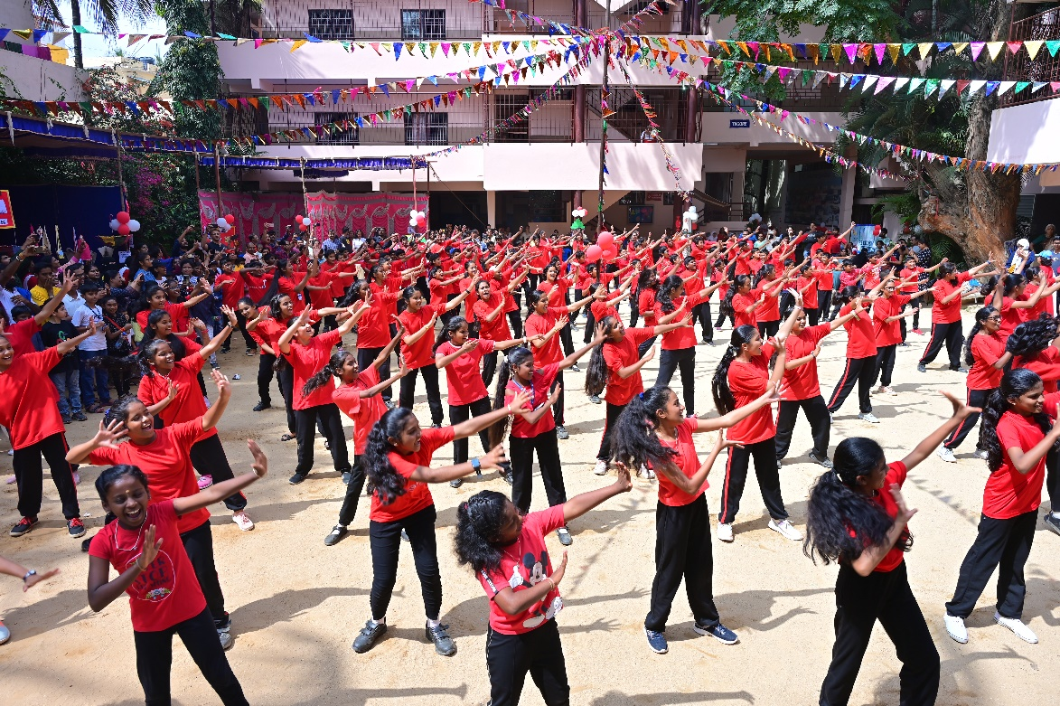
Carnival

Slide 21
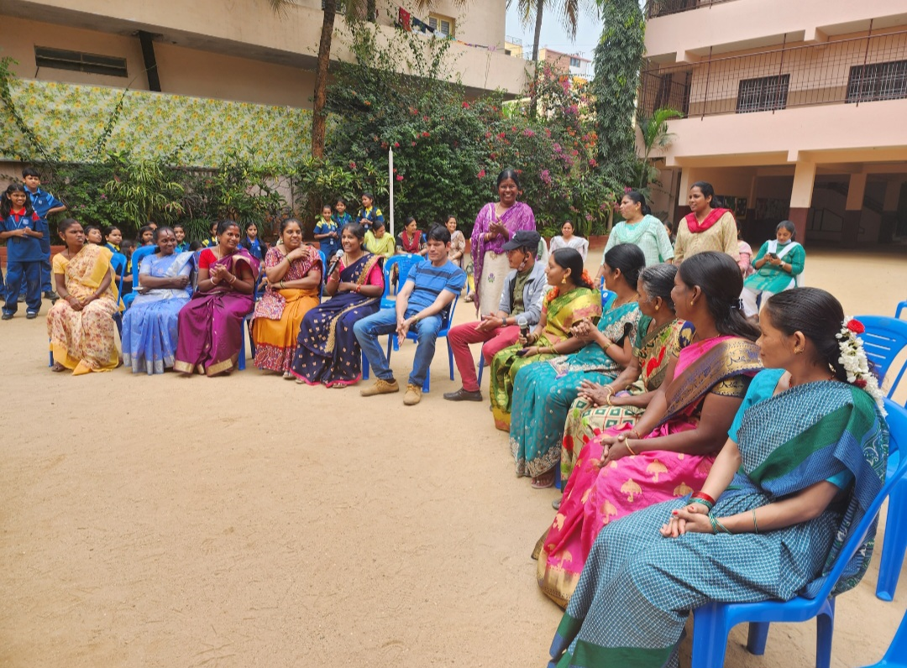
Helpers’ Day

Slide 22
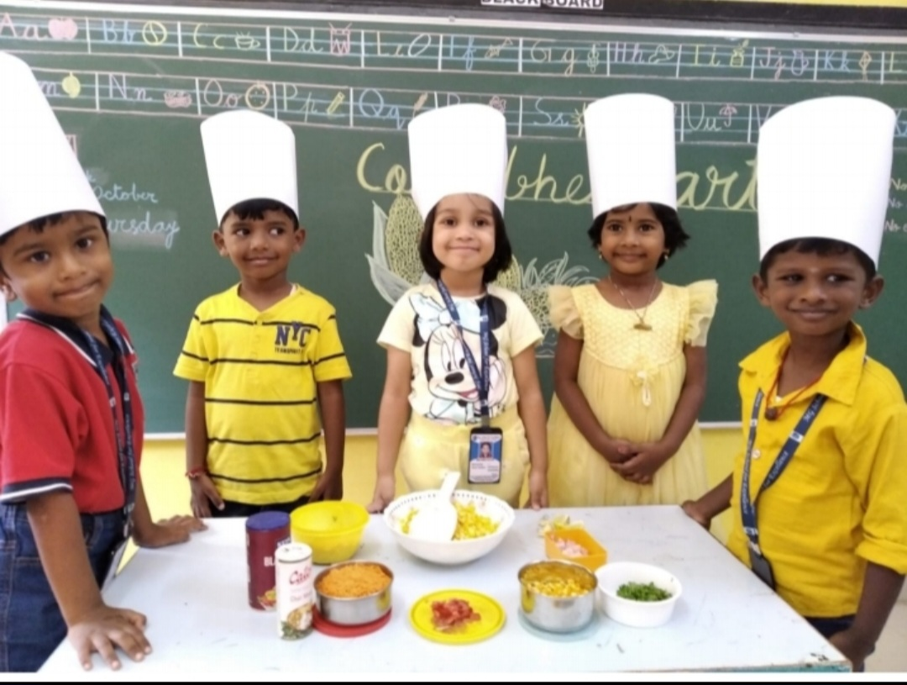
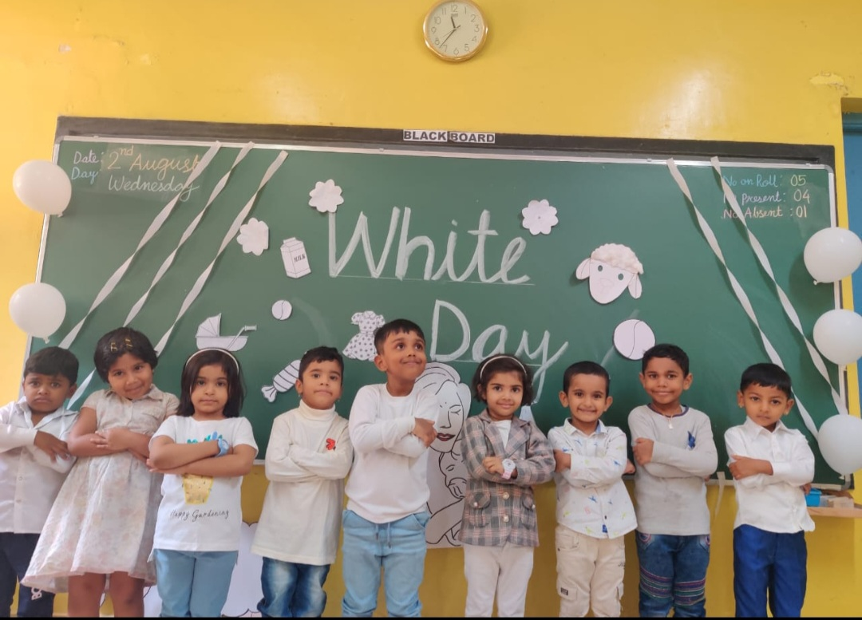
Nursery Activities

Slide 23
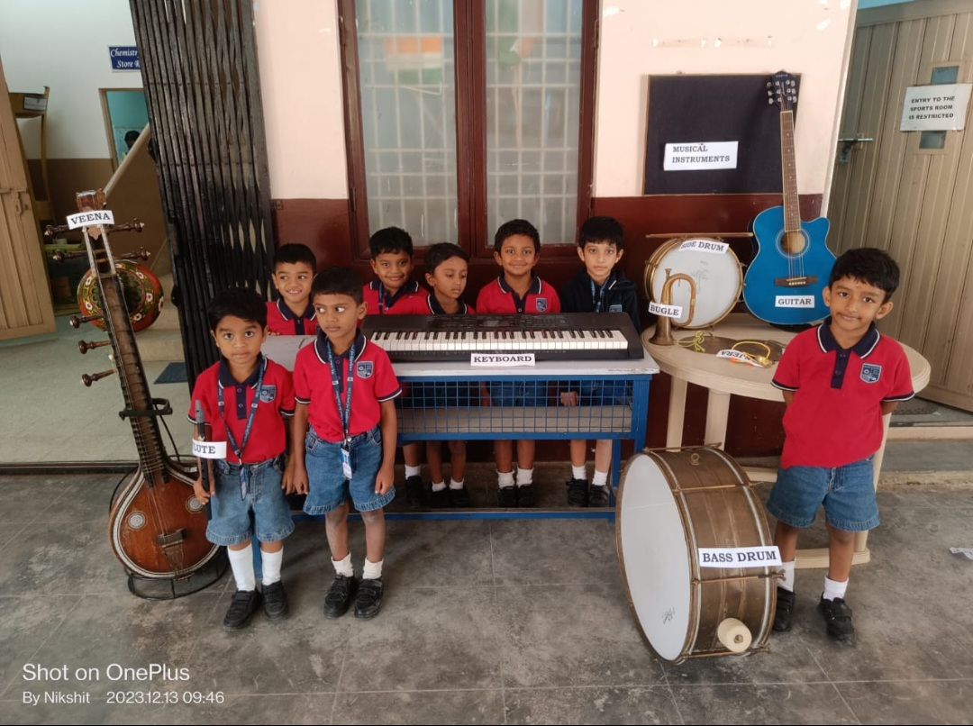
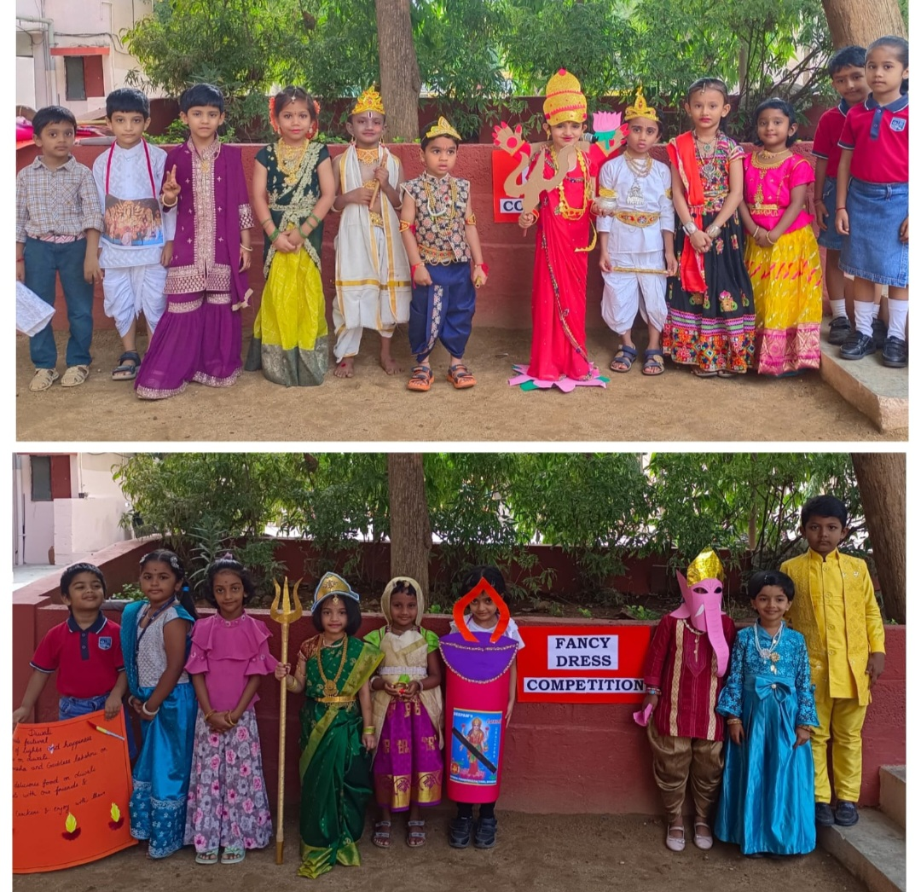
Nursery Activities

Slide 24
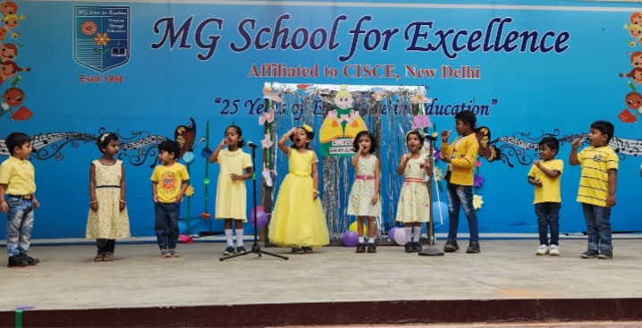
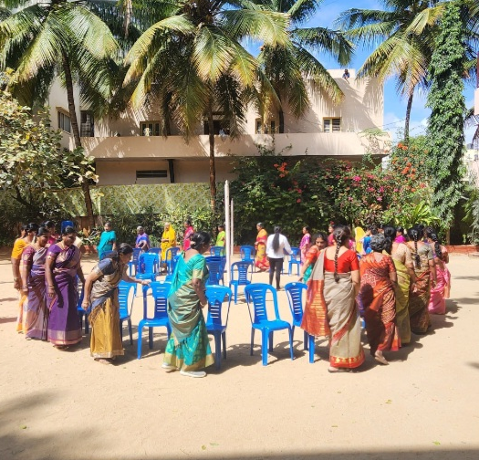
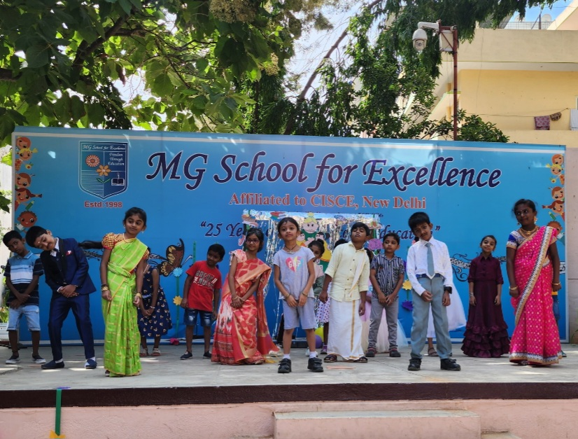
Grand Mother’s Day

Slide 25
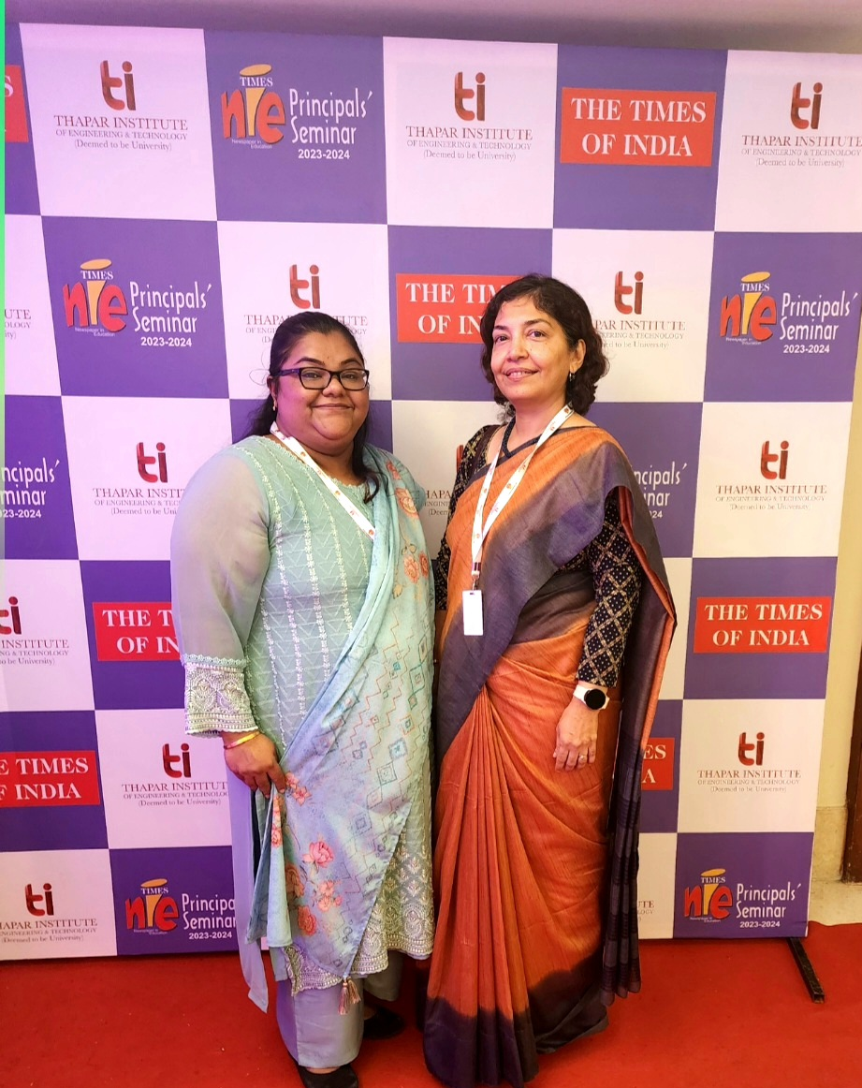
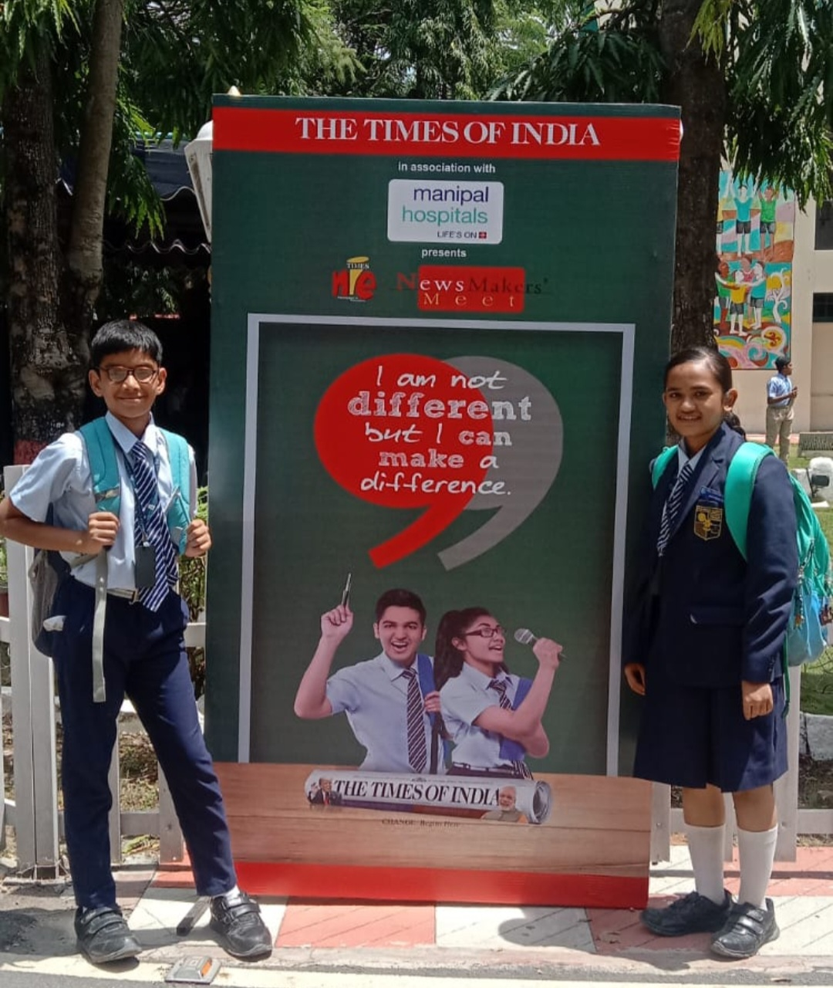
Times - NIE

Slide 26
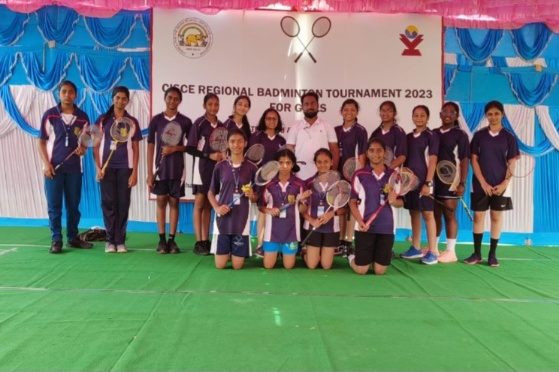
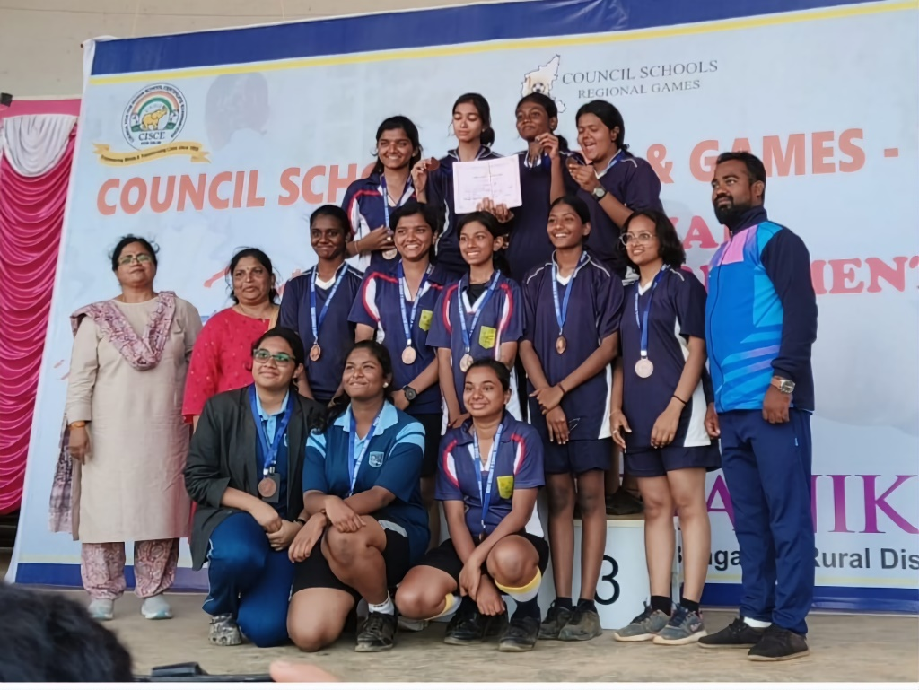
Activities
Sports and Games

Slide 27
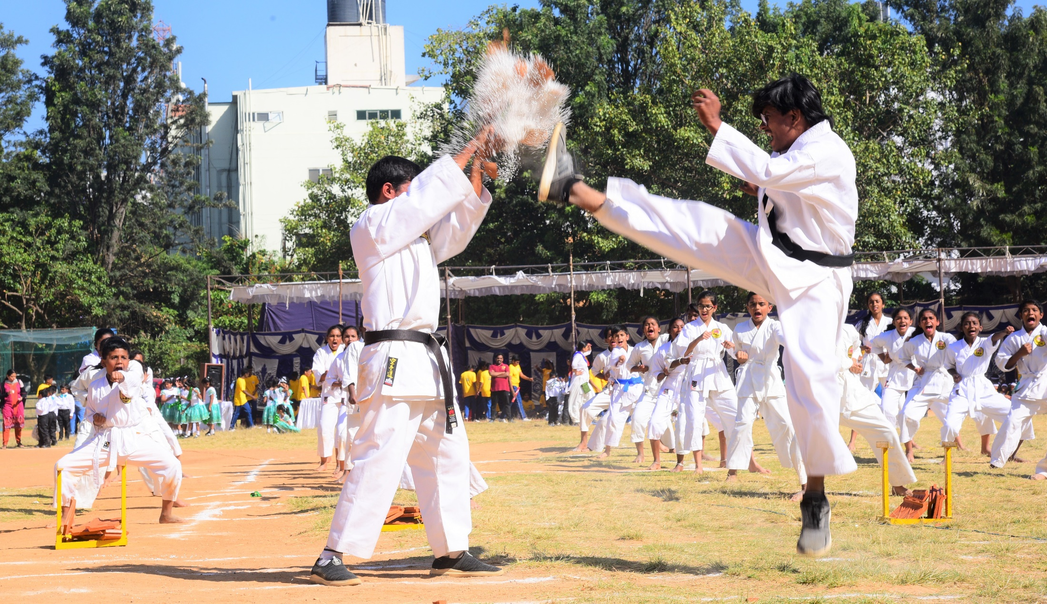
Activities
KARATE

Slide 28
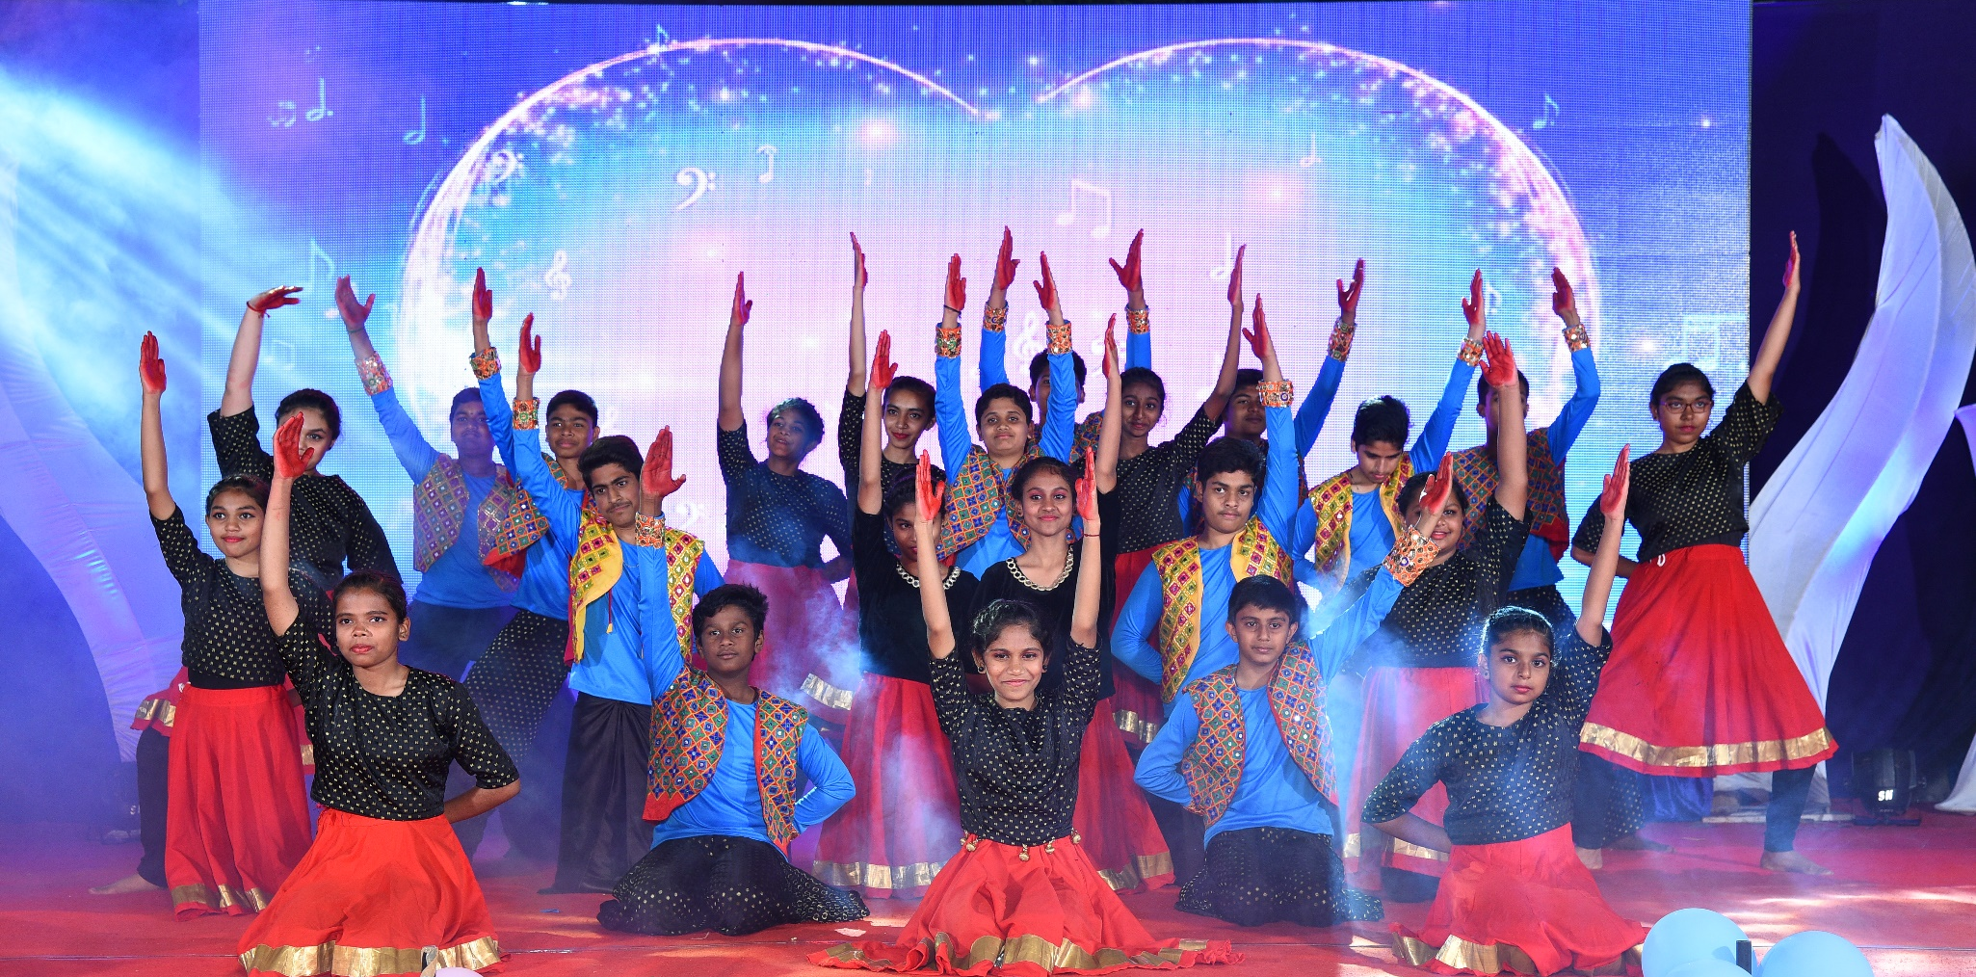
Activities
DANCE

Slide 29
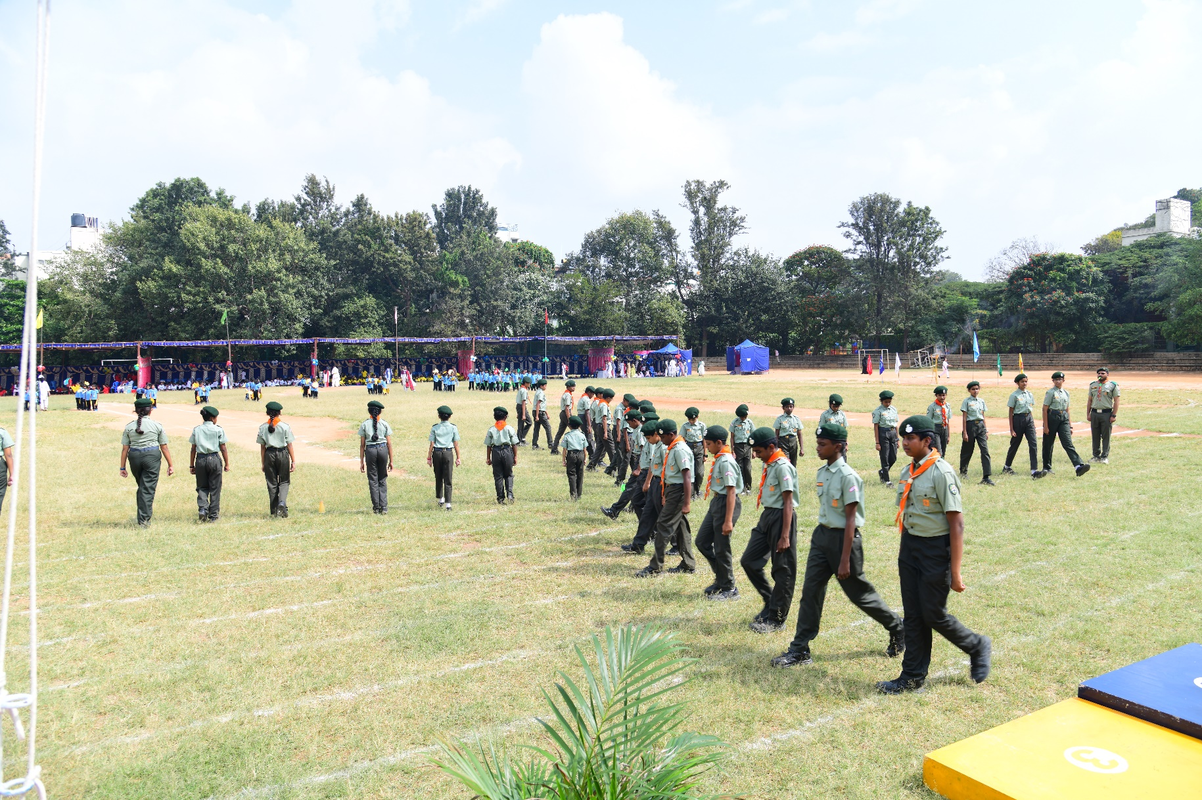
Activities
Scouts and Guides

Slide 30
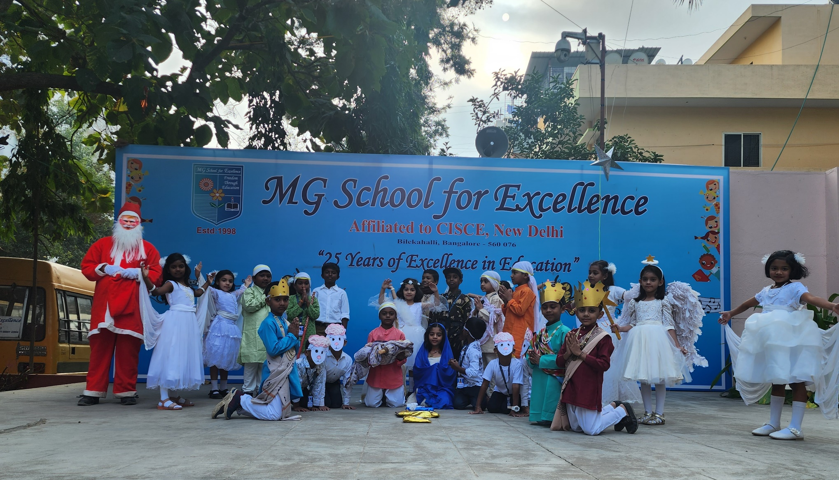
Activities
Morning Assembly

Slide 31
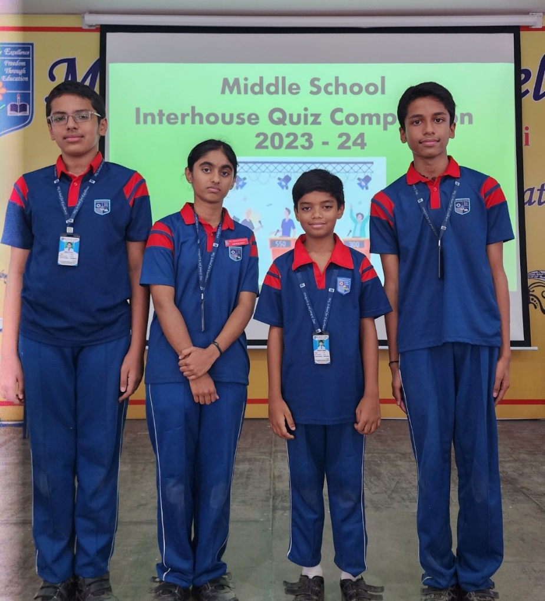
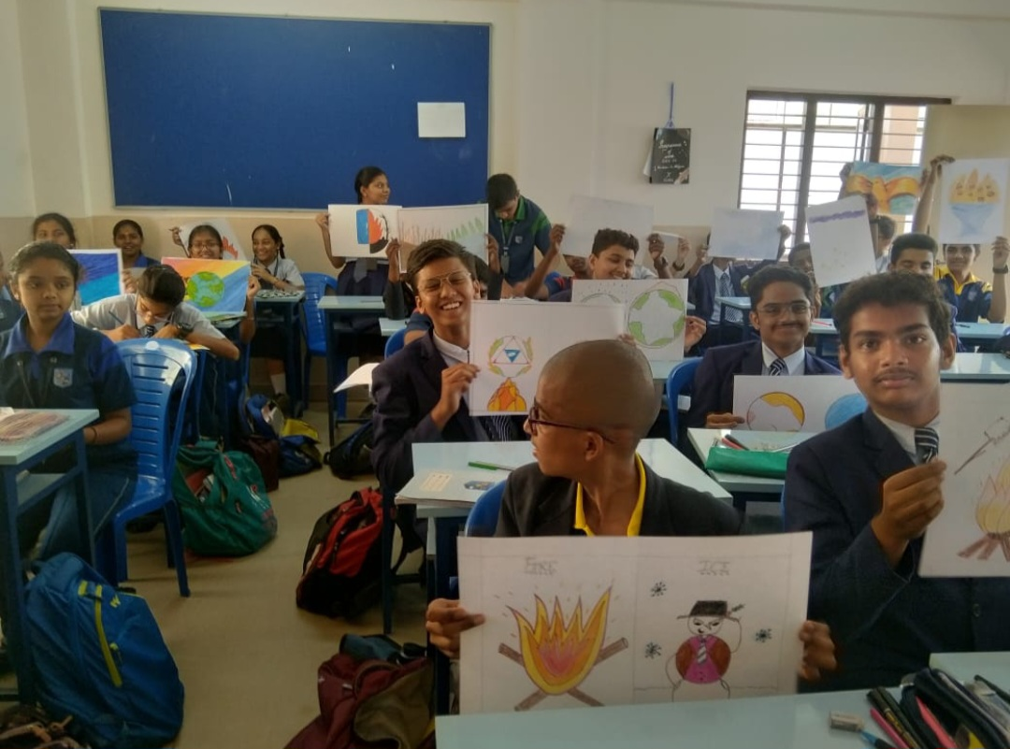
Inter –House Activities

Slide 32
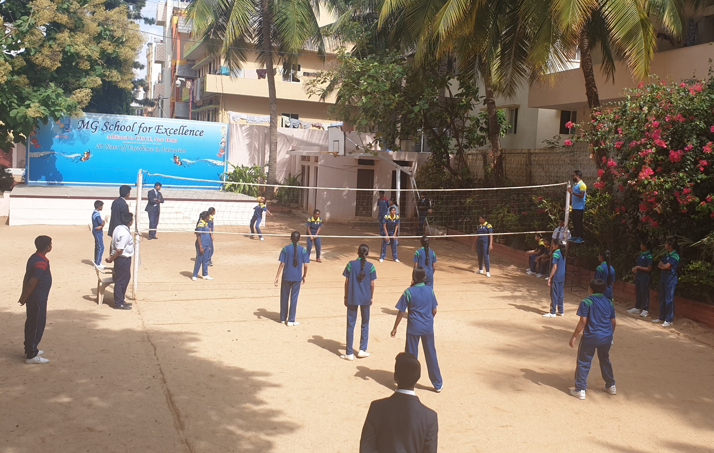
Inter –House Sports and Games

Slide 33
Aptitude Tests
TSE

Slide 34
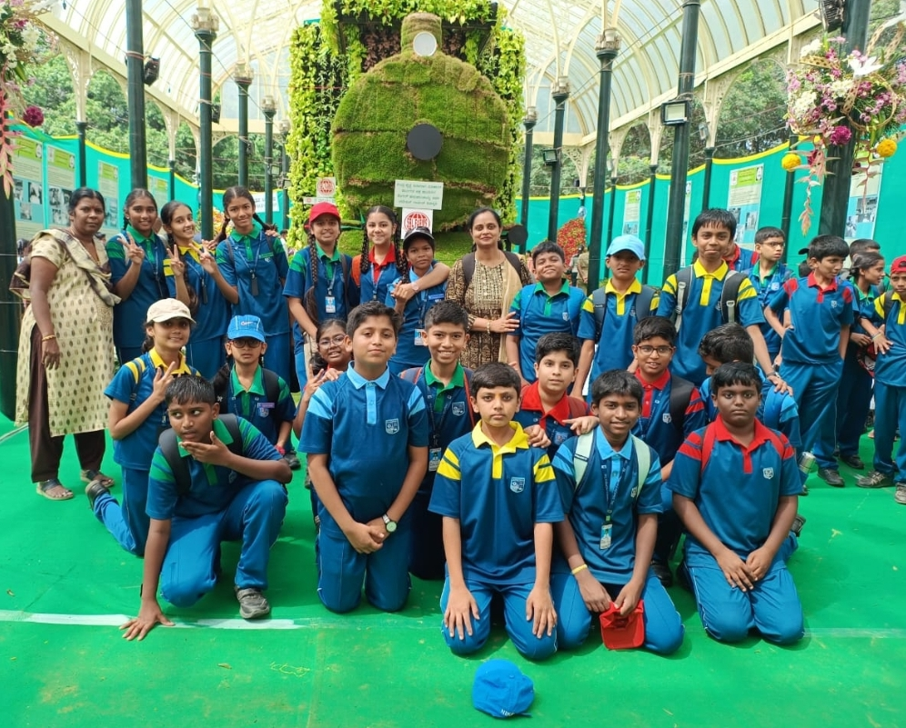
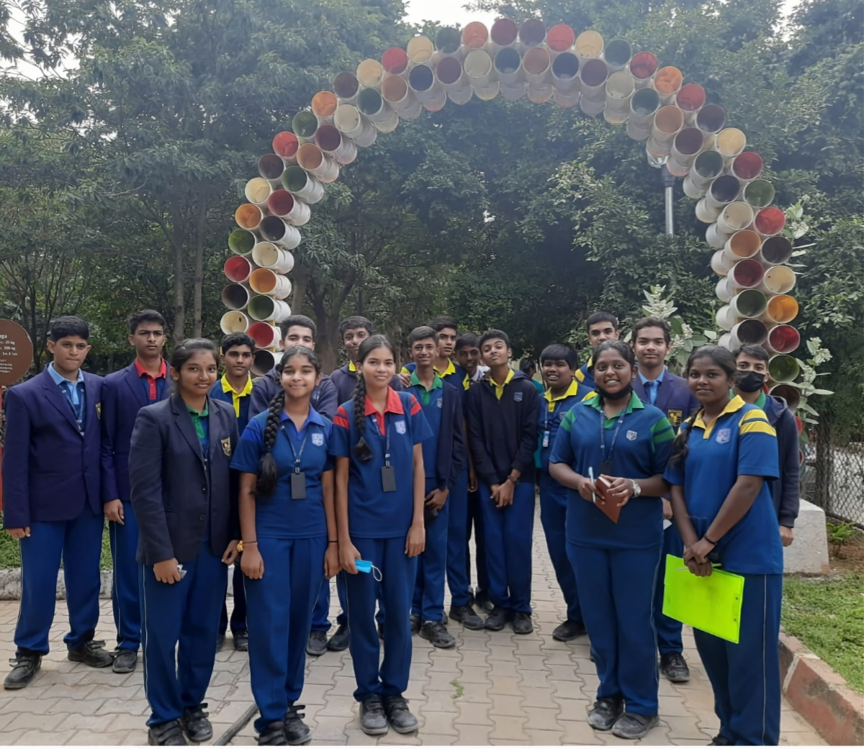
Field Trips

Slide 35
KISA LITERARY FEST

Slide 36
CISCE SPORTS

Slide 37
CISCE SPORTS

Slide 38
CISCE SPORTS

Slide 39
CISCE SPORTS

Slide 40
Mrs. Jean George
Principal
President of Karnataka ICSE Schools Association (KISA)
Convener Examination - Zone C

Slide 41
Teaching Staff

Slide 42
Office Staff

Slide 43
Support Staff

Slide 44
THANK YOU

